Slide 1
Environmental Management Bureau Region 6 DENR
RA 9275 : THE PHILIPPINE CLEAN WATER ACT
Engr. Cristina Ruth B. Desuyo / Rizza Daphet Catague
February 27, 2020

Slide 2
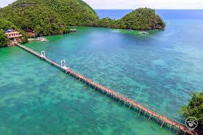
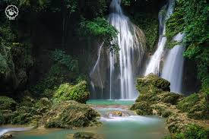
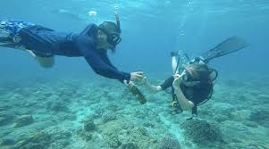
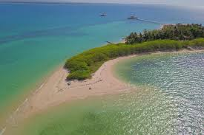

Slide 3
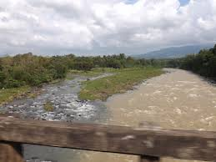
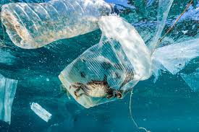
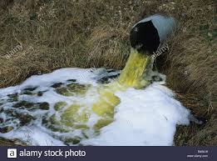
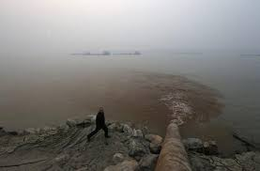

Slide 4
WATER
Water is one of the most essential molecules on earth – life cannot exist without it
Water is a major component of all living things
Important physiologically
Important ecologically
Human importance

Slide 5
Natural erosion and elutriation of
Minerals.
Natural biological processes.
Point and non point source
Waste loads
Background atmospheric deposition
And air-water chemical equilibria
COMBINES w/ WATER AND
SEDIMENT QUALITY
NATURAL WATER AND SEDIMENT
QUALITY
USE BASED WATER AND SEDIMENT
QUALITY STANDARDS
IS WATER USE ATTAINED?
IS NON-ATTAINMENT CAUSED BY
NATURAL SOURCES ONLY ?
NO
YES
NO
YES
WATER BODY IS NOT
POLLUTED
WATERBODY IS POLLUTED
ABATEMENT IS REQUIRED
CONCEPT OF WATER QUALITY

Slide 6
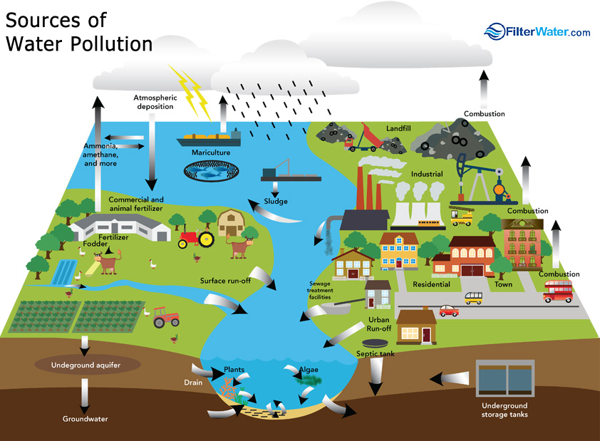

Slide 7
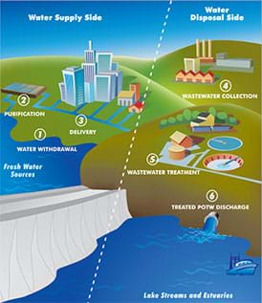
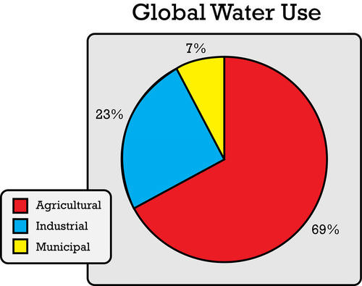

Slide 8
CLEAN WATER ACT (RA 9275) IRR (DAO 2005-10)

Slide 9
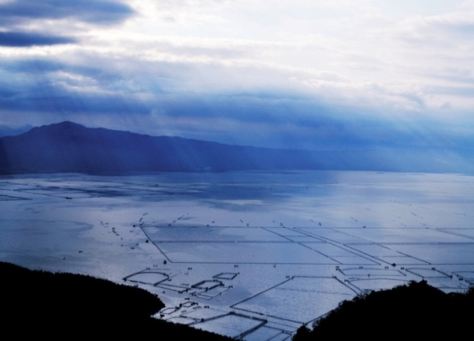
Objective of RA 9275
1.) Develop and implement a
national program for the
protection, preservation,
and revival of the quality
of the country’s
fresh, brackish, and marine water resources.

Slide 10
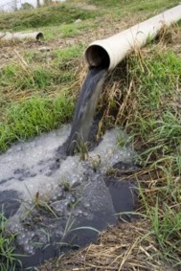
2.) To protect the country’s
waterbodies from pollution
from land-based sources.
3.) To provide comprehensive and integrated strategy to prevent and minimize pollution through multi-sectoral and participatory approach involving all stakeholders .

Slide 11
Philippine Clean Water Act (RA 9275)
enacted on March 22, 2004
published on April 21,2004
took effect on May 6, 2004
Implementing Rules and Regulations of the PCWA of 2004 (DAO 2005-10)
SIGNED by the Secretary on May 16, 2005
published last May 26, 2005 (Manila Times and Manila Standard Today)

Slide 12
Implementing Rules and Regulations of RA 9275
DENR AO 2005-10: IRR of RA 9275
DENR AO 1990-35: Effluent Standards
DENR AO 2016-08: Water Quality Guidelines and General Effluent Standards of 2016
DENR AO 1990-34: Water Quality Criteria (Guidelines)
Notes:
DOH 2007-0012: Philippine National Standards for Drinking Water is part of the Other Obligations
12

Slide 13
CLEAN WATER
DAO 90-34
Classification of Waterbodies
Water Quality Criteria
DAO 90-35
Effluent Standards
RA 9275 (DAO 05-10)
Phil. Clean Water Act
FRESH WATERS:
Class AA
Class A
Class B
Class C
Class D
MARINE WATERS:
Class SA
Class SB
Class SC
Class SD
WQMA
Septage Mgt.
WDP
Prohibited Acts
Linkage Mechanism
Fines, Damages &
Penalties
PROGRAMS:
Industrial Ecowatch
Sagip-Ilog
Adopt-an-
Estero/Waterbody
Beach Ecowatch
Pollution Case

Slide 14
Basic Compliance Requirements
Secure Discharge Permit
Comply with Discharge Permit Conditions
Comply with Applicable Effluent Standards based on effluent analysis through EMB-accredited laboratory
Completely Fill-out Module 3 of the Self Monitoring Report

Slide 15
Section 3. Coverage of RA 9275
Water Quality Management in all water bodies
Primarily apply to abatement and control of pollution from land-based sources
Enforcement of water quality standards, regulations and penalties

Slide 16
The CWA (RA
9275) & its IRR (DAO 2005-10)

Slide 17
COVERAGE
General Application - Water Quality Management in all water bodies
Primary Application - abatement & control of pollution from land based sources
Enforcement of WQ standards, regulations and penalties – irrespective of source of pollution

Slide 18
Water Quality Management Area (WQMA)
– sec 5
The Department, in coordination with National Water Resources Board (NWRB), shall designate certain areas as water quality management areas using appropriate physiographic units such as watershed, river basins or water resources regions.

Slide 19
Designated WQMAs (37)
Calao-Delinquente-Diadi River System WQMA (DAO 2015-13) (Region 2)
Upper Amburayan River System WQMA (DAO 2018-02) (CAR)
Balili River WQMA (DAO 2013-05) (CAR)
Naguilian River System WQMA (DAO 2016-18) (Region 1)
Bued River System WQMA (DAO 2016-03) (CAR)
MaNaTuTi River System WQMA (DAO 2018-10) (NCR)
Imus – Ylang Ylang – Rio Grande Rivers WQMA (DAO 2013-02) (Region 4A)
Cañas-Maalimango Rivers WQMA (DAO 2016-19) (Region 4A)
Pinacanauan de Tuguegarao River WQMA (DAO 2013-06)
(Region 2)
Lower Amburayan River System WQMA (DAO 2018-03) (Region 1)
Sinocalan-Dagupan RS WQMA (DAO 2011-14) (Region 1)
Marilao-Meycauayan-Obando River System WQMA
(DAO 2008-07) (Region 3)
San Juan River System WQMA (DAO 2012-04) (NCR)
Las Pinas-Paranaque River System WQMA (DAO 2018-12) (NCR)
Iyam-Dumacaa River System WQMA (DAO 2018-11) (Region 4A)
Areas within LLDA jurisdiction (RA 9275)
Naga River Watershed WQMA (DAO 2016-04) (Region 5)
Calapan River WQMA (DAO 2013-03) (Region 4B)
Sabang Bay WQMA (DAO 2016-06) (Region 4B)
Coron Bay WQMA (DAO 2016-05) (Region 4B)
Lake Buhi Watershed WQMA (DAO 2013-16) (Region 5)
Ormoc Bay and its Associated Watersheds WQMA
(DAO 2013-21) (Region 8)
Dupong, Matlang and Merida WQMA (DAO 2018-04) (Region 8)
Jalaur River System (DAO 2014-08) (Region 6)
Butuanon River Watershed (DAO 2014-05) (Region 7)
Tigum-Aganan Watershed (DAO 2006-18) (Region 6)
Iloilo-Batiano RS WQMA (DAO 2009-11) (Region 6)
Tagoloan River Basin WQMA (DAO 2016-16) (Region 10)
Cagayan de Oro River Basin and Adjacent Rivers (DAO 2013-18) (Region 10)
Tumaga River WQMA (DAO 2013-01) (Region 9)
Taguibo River WQMA (DAO 2012-11) (Region 13)
Ayala River WQMA (DAO 2016-15) (Region 9)
Talomo River WQMA (DAO 2016-17) (Region 11)
Davao River WQMA (DAO 2013-04) (Region 11)
Silway River WQMA (DAO 2010-10) (Region 12)
Lake Sebu WQMA (DAO 2016-14) (Region 12)
Sarangani Bay WQMA (DAO 2009-12) (Region 12)

Slide 20
Water Quality Management Area (WQMA)
GB – Formulate strategies to coordinate policies for implementing CWA.
GB – Monitor the action
Each WQMA will have its own multi-sectoral group to establish and
conduct WQ surveillance & monitoring network. The group shall report to
GB.
Technical support by Secretariat, composed of experienced 1 lawyer; 1
Geol/Biol; 1 C.E./Hydrologist; and 1 Chem /Chem. Engr. /San.Engr.

Slide 22
National Sewerage & Septage Management Program - sec 7
A priority listing of sewerage, septage and combined systems/project for LGUs based on relevant considerations for the protection of water quality
LGUs may enter into BOT or joint venture agreement w/ private sector for constructing, rehabilitating and/or operation of such facilities
Each LGU shall appropriate land, including right-of-way/ road access for construction of sewage and septage treatment facilities.

Slide 23
Section 8. Domestic Sewage Collection, Treatment and Disposal
Highly Urbanized Cities (HUCs)
Agency vested to provide water supply and sewerage facilities and/or concessionaires are to connect existing sewage lines into available sewerage system
Non-HUCs
DPWH in coordination with DOH and other concerned agencies shall formulate guidelines for the disposal of sewage; employ septage or combined sewerage-septage management system

Slide 24
Sewage (Domestic Wastewater)
Connect to sewer lines for treatment by water concessionaires/water districts/LGUs, or;
Restructure the drainage system to connect to existing wastewater treatment facility
Effluent from sewage treatment plant MUST comply with effluent standards
Must also be covered by a Discharge Permit

Slide 25
Section 22. Linkage Mechanism
DENR - Lead Government Agency
PCG - enforce water quality standards in marine waters, specifically offshore sources
DPWH - provide sewage and sanitation facilities
DA - prepare guidelines for safe reuse of wastewater for agricultural usage and control and abatement of pollution from agri/aquacultural activities. (AO 2007 -26)

Slide 26
Section 22. Linkage Mechanism
DOH – set, revise, enforce drinking water quality standards
DOST – evaluate, verify, develop and disseminate pollution prevention and cleaner production technology
DepED, CHED, DILG, and PIA – prepare and implement a comprehensive and continuing public education and information program

Slide 28
Adopt-an-Estero/Water Body Program - Adopt-an-Estero/Water Body Program is a collaborative undertaking between and among the Estero Community, Donor-Partner, Local Government Unit/s, other government agencies and the DENR. - Objectives: Mobilize estero communities in cleaning the estero and enlist their active participation in the actual clean up, and in implementing and preparing plans to sustain a clean estero in the future years.

Slide 29
Why engage stakeholders and partners in the Program? - To institutionalize the Program within the LGUs particularly barangays, towards community empowerment - To ensure sustainability of the program and benefits derived - - To boost public-private partnership

Slide 30
Who is an Estero Donor/Partner? - A Donor/Partner may be a business establishment, an industry association, a non-government organization or any other group that volunteers to be a major actor in cleaning the esteros. - The donor may accept full undertaking in the clean-up of an estero or may just provide equipment and manpower to do actual clean-up in partnership with the DENR and other donors.

Slide 31
Memorandum of Agreement (MOA) - The donor-partner will enter into an agreement with the DENR; - The MOA will spell out the roles, responsibilities and tasks of the donor-partner, LGU and the DENR

Slide 32
The Donor Partner Tasks & Responsibilities - Sign a MOA with DENR  - Organize a Linis Estero Team - Participate in clean-up planning sessions with the DENR, LGU and with the target estero communities Prepare a Comprehensive Clean-Up Plan for the “adopted estero” - Provide resources (equipment, personnel, funds, time) to carry out the comprehensive clean up plan. - Set up a Monitoring and Evaluation System to determine progressively the accomplishments vis-à-vis the plan and be able to effect corrective/ enhancement actions

Slide 33
AMBIENT WATER QUALITY MONITORING

Slide 34
PLANT
Upstream
Outlet 1
River
Mixing Zone
Downstream

Slide 36
WASTEWATER CHARGE SYSTEM – Sec.13
→ Established on the basis of payment to government for discharging wastewater into the water bodies
→ Based on net waste load (diff. of initial load of abstracted water to waste load of discharged effluent),
→ Complying industries to be charged minimal reasonable amount

Slide 37
PERMITS AND CHARGES
u = fixed permit fee + variable load-based charge
u Fixed permit fee (As tabulated, based on discharge volume), validity of up to 5 yrs maximum, accrues to NWQMF
u Variable load-based charge - based on net waste load (for now, only TSS or BOD); paid annually in advance, accrues to AWQMF
u Actual pollution load may vary (based on SMR); if proved, may serve as basis for adjustment of fee for the following year.

Slide 38
DISCHARGE PERMIT (DP) – sec. 14
→ Legal authorization to discharge wastewater , as granted by DENR
→ Permit specifies ff, among others: the allowed effluent quantity and quality; compliance schedule; monitoring equipment

Slide 39
PERMIT FEE
u Specifies quantity and quality of effluent (should not exceed standards)
u Source of NWQMF
u 5 yrs - Maximum effectivity of
Volumetric Rate of Discharge | Annual Fee (PhP) | Annual Fee (PhP)
 | W/O Metals | W/ Metals
< 10 | 2,000 | 2,600
>10 – 30 | 2,200 | 2,800
>30 - 100 | 2,500 | 3,100
>100 - 150 | 2,700 | 3,300
>150 | 3,300 | 3,900

Slide 40
Wastewater Charge – sec. 13
Formula :
WDF = L_{n} x R
Where:
R is the rate per kilogram (PhP/kg) which is initially fixed at P5.00 per kilogram for priority pollutant parameter (e.g. BOD or TSS )
L_{n} refers to the net waste load (kg/year)

Slide 41
Wastewater Charge . . . /2
L_{n (BOD5/TSS)}= [( C_{f} – C_{a} ) (Q_{f} x N_{f} )] x 0.001
u C_{f} = Average daily effluent concentration (mg/l) for priority pollutant parameter (BOD or TSS);
u Q_{f} = Average daily volumetric flow rate measurement of final discharge effluent (m3/day) and
u N_{f} = Total number of discharge days in a year (days/ year).
u C_{a} = Average water quality concentration for priority pollutant parameter (BOD or TSS) of abstracted or intake water (mg/l).

Slide 42
Name of Firm
Name of Firm
Plant Address

Slide 43
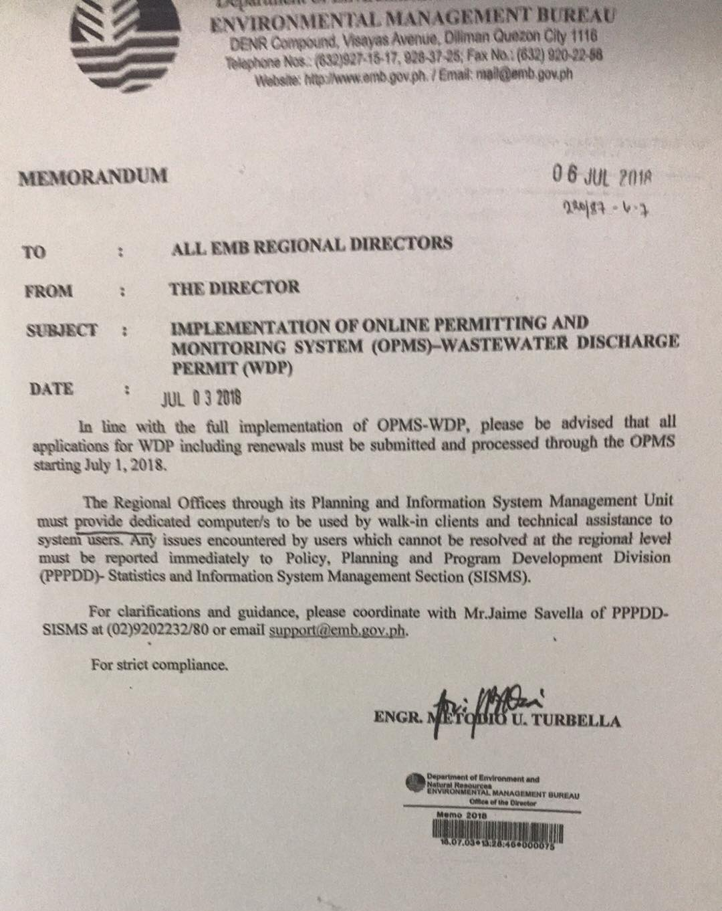
DENR MEMORANDUM
Pursuant to the Memorandum dated July 3, 2018 signed by the EMB Director. Wastewater Discharge Permit must be processed online.

Slide 44
Inspection of Firms
Important Information:
1. Validity of permits
2. Self-Monitoring Reports (SMRs)-quarterly/monthly
3. Results of Laboratory Analysis (RLAs)-quarterly
4. Records – plant’s/WTF’s operation
5. Sources/volume/treatment/disposal of wastes
(solid, wastewater, hazardous wastes, etc.)
6. Discharges, no. of outlets, receiving body of water
& its classification
7. Other observations

Slide 45
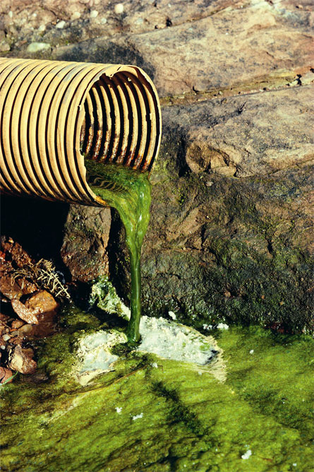
Section 27. Prohibited Acts of
RA 9275
a.discharging or depositing any water pollutant to the water body which could cause water pollution, or impede natural flow in the water body
b.discharging, injecting or allowing
to enter into the soil, anything
that would pollute groundwater

Slide 46
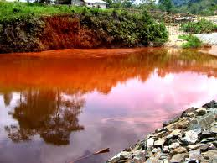
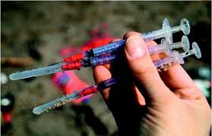
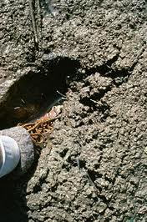
c.operating facilities that
discharges regulated water
pollutants without the required
permits
d.disposal of potentially
infectious medical waste
into sea by vessels
e.unauthorized transport or
dumping into waters of
sewage sludge or solid waste

Slide 47
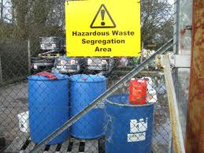
f.transport, dumping or discharge
of prohibited chemicals,
substances or pollutants listed
under RA 6969 (toxic chemicals, hazardous – such as used
oil and nuclear waste control act)
g.discharging regulated water pollutants without the valid
required discharge permit
h.refusal to allow entry, inspection and monitoring as well
as access to reports and records

Slide 48
i.refusal or failure to submit reports and/or designate Pollution Control Officer
j.directly using booster pumps in the distribution system or tampering with the water supply in such a way to alter or impair the water quality

Slide 49
k.operate facilities that discharge or allow to seep, willfully or through grave negligence, prohibited chemicals, substances, or pollutants listed under RA 6969, into water bodies
l.undertake activities or development and expansion of projects, or operating wastewater treatment/sewerage facilities in violation of PD 1586 and its IRR

Slide 50
Section 28. Fines, Damages and Penalties
Fine
P10-200T/ day of violation
subject to the PAB discretion

Slide 51
Section 28. Fines, Damages and Penalties
Gross Violation
Imprisonment - 6 to 10 years
Fine - P 0.5-3M / day
5 or more violations of any of the prohibited acts within 2 years
deliberate discharge of pollutants per RA 6969
blatant disregard of PAB order

Slide 53
DENR Administrative Order No. 2016-08 Water Quality Guidelines
and General Effluent Standards of 2016
Classification of water bodies in the country
Determination of time trends
Evaluation of stages of deterioration/enhancement in water quality
Evaluation of the need for taking actions in preventing, controlling, or abating water pollution
Designation of water quality management (WQMA)
Setting the General Effluent Standards (GES)
areas

Slide 54
Section 3. Scope and Coverage
The scope of the GES was defined to apply to all point sources of pollution, regardless of volume, that discharge to receiving body of water or land and be used regardless of the industry category.

Slide 55
Section 5. Classification of Water Bodies
The classification of freshwater and marine waters
were
generally adopted from DAO 1990-34 and DAO 1997-23 respectively - with some changes, including the following:
Change of classification of waters used for agriculture, irrigation, and livestock watering from Class D to Class C
Removal of Industrial Water Supply from Class C, Class D, and Class SD
Defining Class D and SD for navigable waters

Slide 56
Table 1. Water Body Classification and Usage of Freshwater
Classification | Intended Beneficial Use
Class AA | Public Water Supply Class I – Intended primarily for waters having watersheds, which are uninhabited and/or otherwise declared as protected areas, and which require only approved disinfection to meet the latest PNSDW
Class A | Public Water Supply Class II – Intended as sources of water supply requiring conventional treatment (coagulation, sedimentation, filtration and disinfection) to meet the latest PNSDW
Class B | Recreational Water Class I – Intended for primary contact recreation (bathing, swimming, etc.)
Class C | Fishery Water for the propagation and growth of fish and other aquatic resources Recreational Water Class II – For boating, fishing, or similar activities For agriculture, irrigation, and livestock watering
Class D | Navigable waters
Note: For unclassified water bodies, classification shall be based on the beneficial use as determined by the Environmental Management Bureau (EMB).

Slide 57
Table 2. Water Body Classification and Usage of Marine Waters
Classification | Intended Beneficial Use
Class SA | Protected Waters – Waters designated as national or local marine parks, reserves, sanctuaries, and other areas established by law (Presidential Proclamation 1801 and other existing laws), and/or declared as such by appropriate government agency, LGUs, etc. Fishery Water Class I – Suitable for shellfish harvesting for direct human consumption
Class SB | Fishery Water Class II – Waters suitable for commercial propagation of shellfish and intended as spawning areas for milkfish (Chanos chanos) and similar species Tourist Zones – For ecotourism and recreational activities Recreational Water Class I – Intended for primary contact recreation (bathing, swimming, skin diving, etc.)
Class SC | Fishery Water Class III – For the propagation and growth of fish and other aquatic resources and intended for commercial and sustenance fishing Recreational Water Class II – For boating, fishing, or similar activities Marshy and/or mangrove areas declared as fish and wildlife sanctuaries
Class SD | Navigable waters
Note:
For unclassified water bodies, classification shall be based on the beneficial use as determined by EMB.

Slide 58
d) Maximum allowable limit for secondary metals and organics parameters.
f) For water quality parameters that are naturally occurring in the Philippines, the natural background concentration as determined by EMB shall prevail if the concentration is higher that the WQG; provided that the maximum increase is only up to 10 percent and that it will not cause any risk to human health and the environment.

Slide 59
Section 7. General Effluent Standards
The GES shall be enforced to all point sources of pollution, regardless of volume, that discharge to receiving body of water or land and be used regardless of the industry category.

Slide 60
COMPLIANCE MONITORING OF COMMERCIAL AND INDUSTRIAL ESTABLISHMENTS

Slide 61
Categories of industry sector.
The DENR shall, through due public consultation, revise and publish a list of categories of industry sector for which effluent standards will be provided for each significant wastewater parameter per industry sector.

Slide 62
SECTION 7.0 General Effluent Standards. Discharges from any point source shall at all times meet the effluent standards set forth in Tables 2-3 to maintain the required water quality per water body classification. The GES shall be used regardless of the industry category.
Effluent used for irrigation and other agricultural purposes shall conform to the Department of Agriculture Administrative Order 2007-26 or the Guidelines on the Procedures and Technical Standards for the Issuance of a Certification Allowing for the Safe Re-use of Wastewater for the Purposes of Irrigation and Other Agricultural Uses.

Slide 63
Effluent quality monitoring procedures (i.e. effluent quality monitoring plan, sampling, QA, QC, etc.) shall be in accordance with the Effluent Quality Monitoring Manual issued through EMB Memorandum Circular 2008-008.
7.1 Significant Effluent Quality Parameters per Sector. For purposes of streamlining compliance and enforcement of the GES, the significant effluent quality parameters per sector are listed in Table 8.

Slide 64
The GES established the Significant Effluent Quality Parameters per Sector consistent with the Philippine Standard Industrial Classification (2009).
Industries shall only be required to monitor effluent quality parameters determined to be significant to them – for example
PSIC Code | Industry Category | Significant Parameters
A. Agriculture, Forestry and Fishing
014 | Animal production | BOD, Total Suspended Solids, Total Coliform (for Class B and SB), Ammonia, Phosphate
032 | Aquaculture (excluding fish pens) | BOD, Total Suspended Solids, Ammonia, Nitrate, Phosphate, Sulfate
B. Mining and Quarrying
05 | Mining of coal and lignite | Color, pH, Total Suspended Solids, Nitrate, Sulfate, Manganese, Iron, Arsenic, Cadmium, Mercury, Lead

Slide 65
PSIC Code | Industry Category | Significant Parameters
35300 | Air conditioning supply and production of ice (except steam production) | Temperature, pH, COD, Ammonia, Nitrate, Phosphate, Sulfate, Chloride, Chromium, Zinc
E. Water Supply; Sewerage, Waste Management and Remediation Activities
36000 | Water collection, treatment and supply (except those intended to prevent pollution) | pH, Total Suspended Solids, Chloride, Fluoride, Iron
37000 | Sewerage (operation of sewer systems or sewage treatment facilities that collect, treat, and dispose of sewage) | BOD, Fecal Coliform, Ammonia, Nitrate, Phosphate, Oil and Grease, Surfactants
38210 | Treatment and disposal of non- hazardous waste | Color, Temperature, pH, COD, Total Suspended Solids, Total Coliform, Ammonia, Nitrate, Phosphate, Sulfate, Chloride, Oil and Grease
38220 | Treatment and disposal of hazardous waste | Color, Temperature, pH, COD, Total Suspended Solids, and other parameters depending on the nature of their activities

Slide 66
PSIC Code | Industry Category | Significant Parameters
56 | Restaurants, food chains, bars and other food/beverage services | BOD, Total Suspended Solids, Oil and Grease, Surfactants
L. Real Estate Activities
681 | Real estate activities with own or leased property | BOD, Fecal Coliform, Ammonia, Nitrate, Phosphate, Oil and Grease, Surfactants
M. Professional, Scientific and Technical Activities
71200 | Technical testing and analysis | All significant parameters depending on the nature of their activity
7210 | Research and experimental development on natural sciences and engineering | All significant parameters depending on the nature of their activity
75 | Veterinary activities | Color, pH, COD, Total Suspended Solids, Fecal Coliform, Oil and Grease, Surfactants
P. Education
85 | Public and private education (including support activities) | BOD, Fecal Coliform, Ammonia, Nitrate, Phosphate, Oil and Grease, and all significant parameters depending on the nature of their activity

Slide 67
Effluent Standards. Consistent with the goal of maintaining the quality of water bodies based on their intended beneficial usages, Table 9 shall be enforced and complied with at all times
Effluent Standards for BOD for Strong Wastewater. For establishments with influent BOD equal to or greater than 3,000 mg/L and the receiving water body is Class C, D, SC, or SD, the applicable effluent standards in Table 10 shall at all times be enforced and complied with.
For parameters other than BOD, Table 9 shall apply.

Slide 68
Table 9. Effluent Standards^{(g)}
Parameter | Unit | Water Body Classification
 |  | AA | A | B | C | D | SA | SB | SC | SD
Physical-Chemical
Ammonia as NH₃-N | mg/L | NDA | 0.5 | 0.5 | 0.5 | 7.5 | NDA | 0.5 | 0.5 | 7.5
BOD | mg/L | NDA | 20 | 30 | 50 | 120 | NDA | 30 | 100 | 150
Boron | mg/L | NDA | 2 | 2 | 3 | 12 | NDA | 2 | 20 | 80
Chloride | mg/L | NDA | 350 | 350 | 450 | 500 | NDA | n/a | n/a | n/a
COD | mg/L | NDA | 60 | 60 | 100 | 200 | NDA | 60 | 200 | 300
Color | TCU | NDA | 100 | 100 | 150 | 300 | NDA | 100 | 150 | 300
Cyanide as Free Cyanide | mg/L | NDA | 0.14 | 0.14 | 0.2 | 0.4 | NDA | 0.04 | 0.2 | 0.4
Fluoride | mg/L | NDA | 2 | 2 | 2 | 4 | NDA | 3 | 3 | 6
Nitrate as NO₃-N | mg/L | NDA | 14 | 14 | 14 | 30 | NDA | 20 | 20 | 30
pH (Range) |  | NDA | 6.0-9.0 | 6.0-9.0 | 6.0-9.5 | 5.5-9.5 | NDA | 6.5-9.0 | 6.0-9.0 | 5.5-9.5
Phosphate | mg/L | NDA | 1 | 1 | 1 | 10 | NDA | 1 | 1 | 10
Selenium | mg/L | NDA | 0.02 | 0.02 | 0.04 | 0.08 | NDA | 0.02 | 0.2 | 0.4
Sulfate | mg/L | NDA | 500 | 500 | 550 | 1,000 | NDA | 500 | 550 | 1,000
Surfactants (MBAS) | mg/L | NDA | 2 | 3 | 15 | 30 | NDA | 3 | 15 | 30
Temperature^{(h)} | ºC change | NDA | 3 | 3 | 3 | 3 | NDA | 3 | 3 | 3
Total Suspended Solids | mg/L | NDA | 70 | 85 | 100 | 150 | NDA | 70 | 100 | 150

Slide 69
Parameter | Unit | Water Body Classification
 |  | AA | A | B | C | D | SA | SB | SC | SD
Metals
Arsenic | mg/L | NDA | 0.02 | 0.02 | 0.04 | 0.08 | NDA | 0.02 | 0.04 | 0.08
Barium | mg/L | NDA | 1.5 | 1.5 | 6 | 8 | NDA | 1.5 | 2 | 8
Cadmium | mg/L | NDA | 0.006 | 0.006 | 0.01 | 0.02 | NDA | 0.006 | 0.01 | 0.02
Chromium as Hexavalent Chromium (Cr⁶⁺) | mg/L | NDA | 0.02 | 0.02 | 0.02 | 0.04 | NDA | 0.1 | 0.1 | 0.2
Copper as dissolved Copper | mg/L | NDA | 0.04 | 0.04 | 0.04 | 0.08 | NDA | 0.04 | 0.04 | 0.08
Iron | mg/L | NDA | 5 | 5 | 7.5 | 35 | NDA | 7.5 | 7.5 | 35
Lead | mg/L | NDA | 0.02 | 0.02 | 0.1 | 0.2 | NDA | 0.02 | 0.1 | 0.2
Manganese | mg/L | NDA | 2 | 2 | 2 | 20 | NDA | 4 | 4 | 40
Mercury | mg/L | NDA | 0.002 | 0.002 | 0.004 | 0.008 | NDA | 0.002 | 0.004 | 0.008
Nickel | mg/L | NDA | 0.1 | 0.2 | 1 | 5 | NDA | 0.2 | 0.3 | 1.5
Zinc | mg/L | NDA | 4 | 4 | 4 | 8 | NDA | 0.1 | 1.5 | 3

Slide 70
Parameter | Unit | Water Body Classification
 |  | AA | A | B | C | D | SA | SB | SC | SD
Organics
Benzo(a)pyrene | µg/L | NDA | 1.5 | 1.5 | 3 | 6 | NDA | 1.5 | 3 | 6
BTEX
Benzene | mg/L | NDA | 0.1 | 0.1 | 0.5 | 5 | NDA | 0.1 | 0.5 | 5
Toluene | mg/L | NDA | 3.5 | 5 | 20 | 25 | NDA | 5 | 20 | 25
Ethylbenzene | mg/L | NDA | 1.5 | 1.5 | 7.5 | 10 | NDA | 1 | 7.5 | 10
Xylenes | mg/L | NDA | 5 | 5 | 15 | 18 | NDA | 5 | 15 | 18
Malathion (Organophosphate) | µg/L | NDA | 1 | 1 | 3 | 6 | NDA | 1 | 3 | 6
Oil and Grease | mg/L | NDA | 5 | 5 | 5 | 15 | NDA | 5 | 10 | 15
Polychlorinated Biphenyls^{(i)} | µg/L | NDA | <0.1 | <0.1 | <0.1 | <0.1 | NDA | <0.1 | <0.1 | <0.1
Phenol & Phenolic Substances^{(j)} | mg/L | NDA | 0.01 | 0.01 | 0.5 | 5 | NDA | 0.01 | 0.5 | 5
Trichloroethylene | mg/L | NDA | 0.7 | 0.7 | 9 | 20 | NDA | 0.7 | 9 | 20
Total Organochlorine Pesticides^{(k)} | µg/L | NDA | <0.419 | 50 | 50 | 50 | NDA | 50 | 50 | 50
Aldrin | µg/L | NDA | <0.02 | <0.02 | <0.02 | <0.02 | NDA | <0.02 | <0.02 | <0.02
Chlordane | µg/L | NDA | <0.02 | <0.02 | <0.02 | <0.02 | NDA | <0.02 | <0.02 | <0.02
DDT | µg/L | NDA | <0.04 | <0.04 | <0.04 | <0.04 | NDA | <0.04 | <0.04 | <0.04
Dieldrin | µg/L | NDA | <0.02 | <0.02 | <0.02 | <0.02 | NDA | <0.02 | <0.02 | <0.02
Endrin | µg/L | NDA | <0.02 | <0.02 | <0.02 | <0.02 | NDA | <0.02 | <0.02 | <0.02
Heptachlor | µg/L | NDA | <0.02 | <0.02 | <0.02 | <0.02 | NDA | <0.02 | <0.02 | <0.02
Lindane | µg/L | NDA | <0.02 | <0.02 | <0.02 | <0.02 | NDA | <0.02 | <0.02 | <0.02
Methoxychlor | µg/L | NDA | <0.03 | <0.03 | <0.03 | <0.03 | NDA | <0.03 | <0.03 | <0.03
Toxaphene | µg/L | NDA | <0.03 | <0.03 | <0.03 | <0.03 | NDA | <0.03 | <0.03 | <0.03

Slide 71
Parameter | Unit | Water Body Classification
 |  | AA | A | B | C | D | SA | SB | SC | SD
Microbiological
Fecal Coliform | MPN/1 00mL | NDA | 4 | 200 | 400 | 800 | NDA | 200 | 400 | 800
Total Coliform | MPN/1 00mL | NDA | 3,000 | 3,000 | 10,000 | 15,000 | NDA | 3,000 | 10,000 | 15,000
Notes:
NDA – No Discharge Allowed
GES values are maximum allowable limit.
GES values for temperature refer to the temperature difference of the background value and discharge point. Specific sampling locations shall be established based on the EMB Ambient Water and Effluent Quality Monitoring Manual. Sampling locations for temperature monitoring, established and approved by EMB, prior to
this Order shall remain valid.
PCBs include the nine Aroclors and 19 individual PCB congeners described in Section 6.1 of this Order.
Phenols include 2-chlorophenol, 2,4-dichlorophenol, and 2,4,6-trichlorophenol
When monitoring for Class A waters, the individual organochlorine pesticides shall be monitored. For Class B, C, D, SB, SC, and SD, Total Organochlorine Pesticides shall be monitored, which refers to the organochlorine
pesticides listed in Table 7-2 plus BHC (☐,β,☐,γ), 4,4’DDD, 4,4’DDE, Endosulfan (I, II, and sulfate).

Slide 72
Section 10. Grace Period
Consistent with RA 9275, a grace period of not more than five (5) years is provided in cases wherein:
Values for the GES have become stringent compared to the values in DAO 1990-35. In such cases, DAO 1990-35 shall apply during the grace period.
New significant effluent quality parameters were identified for the sector
The grace period can only be given to establishments that submit Compliance Action Plan and periodic status of implementation to the
DENR on the steps taken for the establishment's compliance schedule within the prescribed grace period.

Slide 73
DENR MEMORANDUM
Pursuant to the Memorandum dated January 31, 2019 signed by the EMB Director. - Supplementary Clarification on the Coverage of DAO 2016-08 Relative to the granting of not more then 5 years Grace Period.

Slide 74
DENR MEMORANDUM
Section 10 of DAO 2016-08 provides grace period of not more then five (5) years, provided that the establishment submits Compliance Action Plan (CAP and periodic status of implementation to the DENR on the steps taken for the establishment’s compliance schedule within the prescribed period.
The granting of grace period for a.) and b.) shall only apply to wastewater treatment facilities already existing or undergoing actual construction as of the effectivity of DAO No. 2016-08 which is June 15, 2016.

Slide 75
Regulatory Framework of PCO Requirements
uRA 9275: Philippine Clean Water Act of 2004
uChapter 5, Section 27(n) has penal provisions on the refusal or failure to designate PCOs whenever required by DENR

Slide 76
REVISED GUIDELINES FOR POLLUTION CONTROL OFFICERS
(DAO 2014 - 02)

Slide 77
Objectives
To effectively enforce RA 9275 by establishing linkages among the ff:
u DENR
u Industrial establishments which are potential and actual sources of pollution
u Local Government Agencies
To carry out the national policy of maintaining a reasonable quality of the environment

Slide 78
Pollution Control Officer (PCO)
A technical person competent in pollution control and environmental management, performing the duties and responsibilities in a particular establishment and officially accredited by the EMB Regional Office

Slide 79
Thank you

